Slide 1
Assignments
on
Perceptron Learning Algorithm

Slide 2
Assignment 1
Implement AND gate using Single Layer perceptron Algorithm and use test data to verify the model. Consider the following steps:
(a) Train data = [[0,0], [0,1], [1,0], [1,1]], Class Label = [0, 0, 0, 1]
(b) Test data = [[0.1,0.2], [0.2,0.9], [0.8,0.3], [0.8,0.8]],
Expected output = [0, 0, 0, 1]
(c ) Plot the optimal Decision boundary line

Slide 3
Step by step implementation of Single Layer Perceptron
Generate the inputs and known answers
Generate random values of the weights (w1, w2) and bias
Define Activation function (e.g. Step Function)
Find the initial error
Run the algorithm until converges to the right line or run the algorithm with a max number of iterations
Plot the optimal boundary
Test the model using test data.

Slide 4
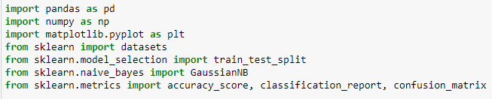
Import files

Slide 5
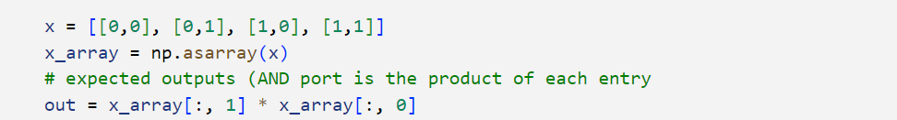
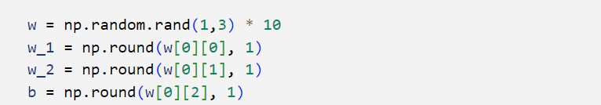
1) Generate the inputs and known answers
2) Generate random values of the weights (w1, w2) and bias

Slide 6
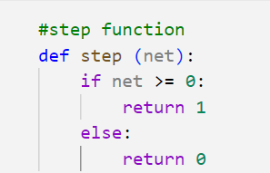
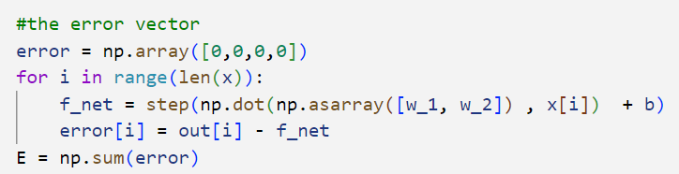
3) Define Activation function (1.e Step Function)
4) Find the initial error

Slide 7
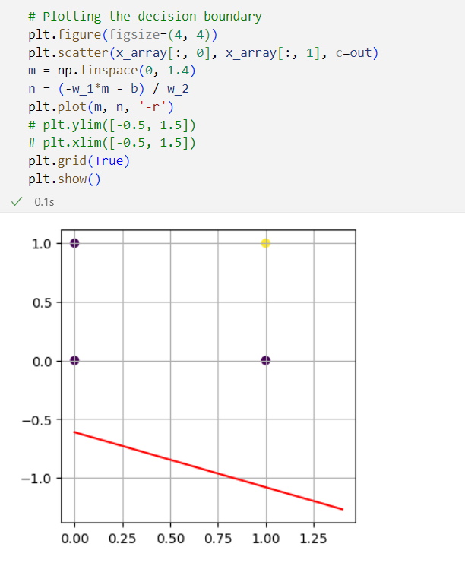
(a) Plot the initial model

Slide 8
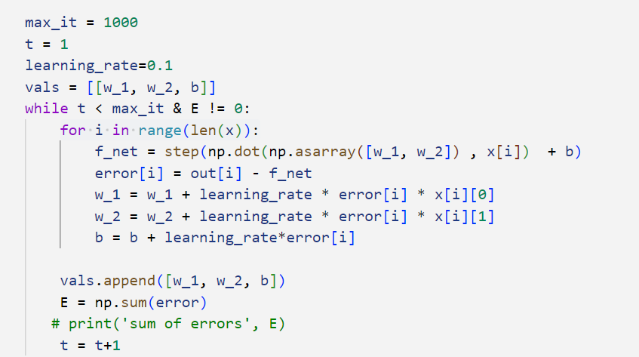
5) Run the algorithm will run until converges to the right line or we run a max number of iterations

Slide 9
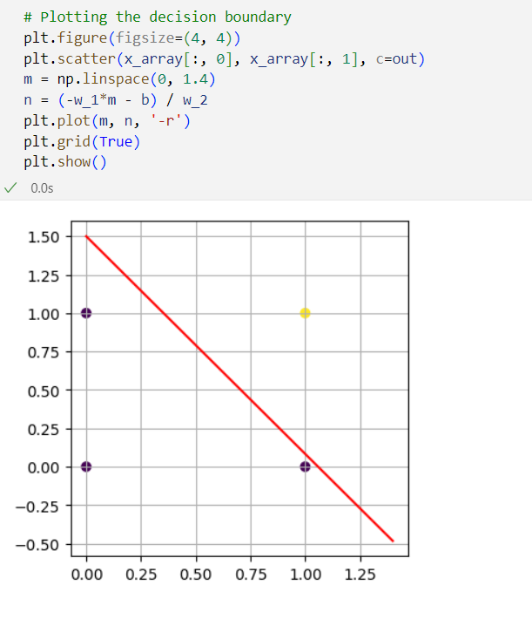
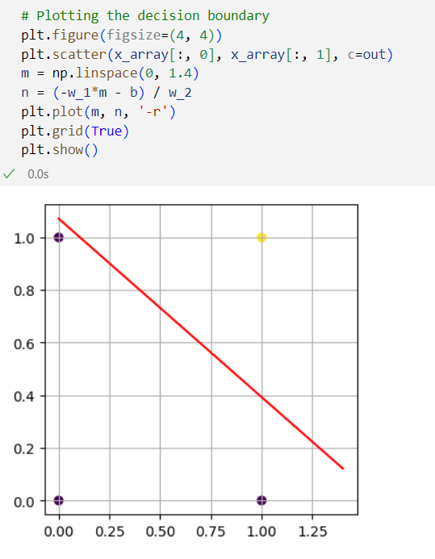
6) Plot the optimal boundary

Slide 10
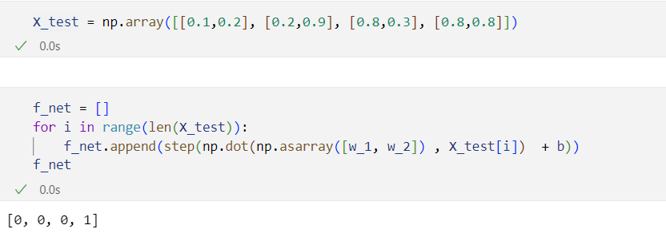
7) Test the model using test data.

Slide 11
Assignment 2
Implement OR gate and NOT Gate using Single Layer perceptron Algorithm and use test data to verify the model.

